Slide 1


Balancing Academic Curriculum using Mutation only Genetic Algorithm
Y V S Murthy, Chakrdhar M,Kunal M, Sri Charan M, Umesh sai R and Shashidhar G. Koolagudi
Department of Computer Science and Engineering,
National Institute of Technology Karnataka,
Surathkal, Mangalore, INDIA – 575 025.
Presented by
Shashidhar G. Koolagudi
At: 11th International Conference on Contemporary Computing (IC3)- 2018,
JIIT, Noida, India.
2nd – 4th August, 2018

Slide 2
Outline
Introduction
Motivation
Applications
Proposed Methodology
Database Collection
Results and Analysis
Conclusion and Future Work
References

Slide 3
Introduction:
The balanced academic curriculum problem consists in the assignation of courses to academic periods satisfying all the load limits and prerequisite constraints .
An intuitive intention would be to have the courses distributed into semesters so that the load of the students over different semesters is as balanced as possible.
In this paper, we present the design of a solution to the balanced academic curriculum problem by using Genetic Algorithm.

Slide 4
Motivation
In most of the colleges, the academic curriculum is divided into semesters. It usually happens that certain semesters are more hectic and crowded and some semesters are comparatively free in terms of the effective academic load of that semester. This makes it difficult for a student learn all the courses effectively and compete with others.

Slide 5
Applications
Students can easily find the suitable academic curriculum with load distributed correspondingly and equally along each semester.

Slide 6
Literature Review
Previously BACP is done using :
Local Heuristics using professor preference
Mathematical model using specific variables and constraints.
Hybrid resolution framework.
Incomplete methods(Genetic algorithm)
Tabu search
Previously used features –Constraint Programming, Genetic modelling, Genetic local search algorithm .

Slide 7
Research Gaps

Slide 8

Proposed BACP Algorithm
Representation :
The representation of a candidate solution is done by using a one dimensional array equals to number o periods ,where each member of the array is a list .
The array equals the number of periods , where the length of each list is determined by the number of assigned courses at a certain period
Fig: Proposed flow diagram for the task of singer identification.

Slide 9
Mutation Operators :
Swap Operator :
In order to apply a number of swaps between different courses of a given individual, the swap operator iterates through a loop for a number of iterations (as specified by sw parameter)
During the course of a single iteration, two distinct periods (i.e p,q ) are selected randomly, and then, their respective feasible courses (i.e. courses that satisfy the perquisite constraint) are enlisted (ie CLp , CLq) .
Afterwards, the first pair of courses, which is obtained by combing courses from CLp , CLq lists and that produces a feasible mutation, is used to mutate the current individual Im ,by swapping the places of the selected courses.

Slide 10
Shift Operator :
The shift operator (see Algorithm 2) is also executed for several iterations, as specified by sh parameter .
During the progress of a given iteration, initially, a random period is selected, and then, one of its courses (i.e. course c ) During the progress of a given iteration, initially, a random period is selected, and then, one of its courses (i.e. course .
Next, the periods that can accept course c , are initially outlined, and then, one of them is selected randomly as the period that will accept the envisioned course.

Slide 11
Initialization
In a typical instance of the academic curricula balancing problem, courses are ordered based on the number of prerequisites they have.
Courses with no prerequisites are placed first then courses with one prerequisite and so on.
At the beginning in order to start with a balanced curricula, in terms of the number of courses, each period is set (estimated) to accept equal number of courses, unless there is an odd number of courses, which requires that some of the periods have an additional course.
Next ,by following the ascending order of the number of perquisites, the courses are dispatched into the available periods, subject to the constraints of min/max credit load and course perquisites
After forming the initial population, we evaluate the fitness of each individual in the population and they are ordered based on their fitness values.

Slide 12
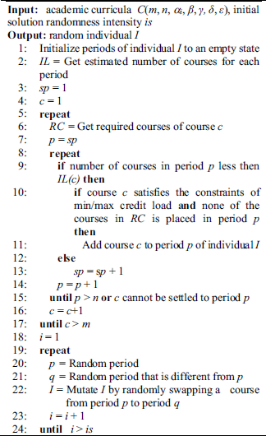

Slide 13
Implementation :
At the very start of the algorithm, a list of two possible operators to be used is defined, which is made of swap and shift operators.
Then, a population P of ps individuals , is created by using the procedure for creating the initial solution . Next, in the repetitive phase of the algorithm, at each iteration, the following steps are undertaken:
Evaluation of all individuals. In case a new best individuals is found, it is saved as the best solution found so far,Formation of the new population by selecting the parents based on tournament selection and fitness function and by mutating them through the operator (i.e. swap or shift) used in the running iteration
Before the next generation commences, based on the af parameter, one of the two operators is picked for acting as a mutation operator in the next stage.

Slide 14
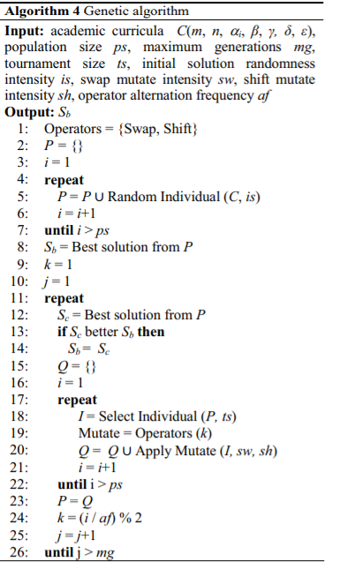
Genetic Algorithm

Slide 15
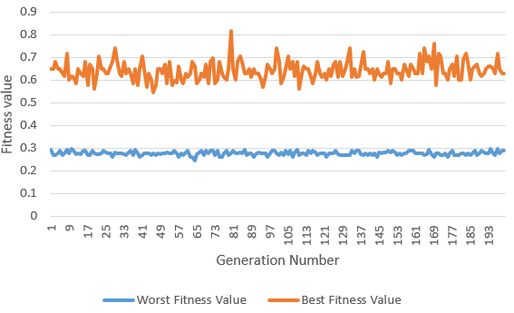
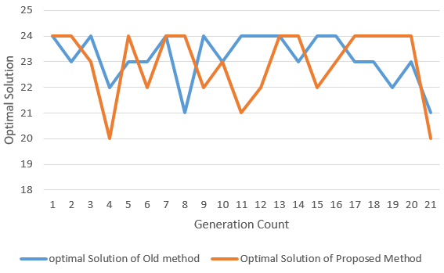
Experimental Analysis
Fitness value comparison
Optimal solution over iterations comparison between proposed and start of art method for BACP12

Slide 16
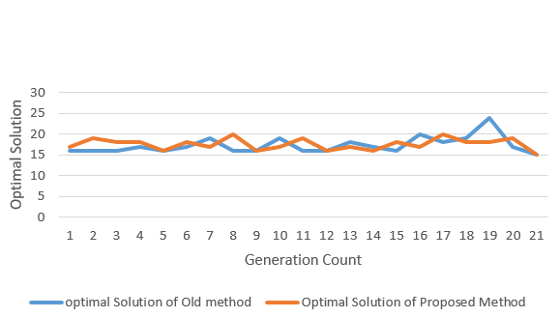
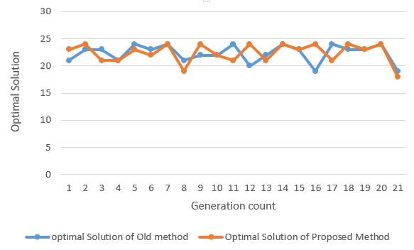
Optimal solution over iterations comparison between proposed and start of art method for BACP10
Optimal solution over iterations comparison between proposed and start of art method for BACP8

Slide 17
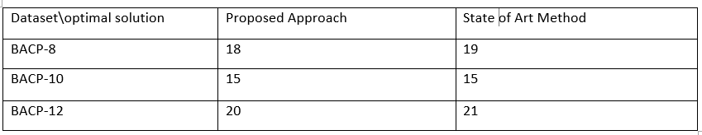
Results
Table: Results obtained using different features and classification models on both the datasets.

Slide 18
Conclusion
we present a modified approach for balancing the academic curricula problem based on genetic algorithm. We used only mutation operators for creating new off springs. The two operators swap and shift are used alternatively and newer solutions are created.
The results show that the algorithm provides solutions that are either on par or better than the solutions obtained by using the state-of-art method. Also, the results shoe that the optimal solution can be achieved in the method proposed with lesser number of generations indicating that the time taken to obtain the optimal solution is lesser and hence it is comparatively effective.

Slide 19
Future work
Some more functionalities can be brought into Academic curriculum like adding set of electives which students can opt and setting a limit on number of electives a student can take.

Slide 20
References
[1] M. Chiarandini, L. Di Gaspero, S. Gualandi and A.Schaerf, ”The balanced academic curriculum problem
revisited,” Journal of Heuristics
[2] C. Castro and S. Manzano, ”Variable and value ordering when solving balanced academic curriculum problems,” in Proceedings of the ERCIM Working Group on Constraints
[3] T. Lambert, C. Castro, E. Monfroy and F. Saubion, ”Solving the balanced academic curriculum problem with an hybridization of genetic algorithm and constraint propagation,” in International Conference on Artificial Intelligence and Soft Computing, Zakopane, 2006.
[4] C. Castro, B. Crawford and E. Monfroy, ”A genetic local search algorithm for the multiple optimisation of the balanced academic curriculum problem,” in Cutting-Edge Research Topics on Multiple Criteria Decision Making, Springer Berlin Heidelberg, 2009, pp. 824-832.
[5] L. V. Rosas-Tllez, J. L. Martnez-Flores and V. Zanella-Palacios, ”Solution to the Balanced Academic Curriculum Problem Using Tabu Search,”
Computer Technology and Application, vol. 3, no. 9, pp. 630-635, 2012.
[6] Kadri Sylejmani, Arbnor Halili, Arbnor Rexhepi ”Mutation only genetic algorithm”.,MIPRO 2017

Slide 21
Thank You

